Slide 1

TRU Open Press
Inaugural Advisory Board Meeting
27 May 2024, 10 am – 11 am

Slide 2

The team at the TRU Open Press is grateful to be visitors on Tk’emlups te Secwepemc territory within the unceded traditional lands of Secwepemcúl’ecw (Secwepemc Nation), where knowledge sharing has taken place since time immemorial.
Photo of the sky in Knutsford by James Wheeler, via Unsplash.

Slide 3
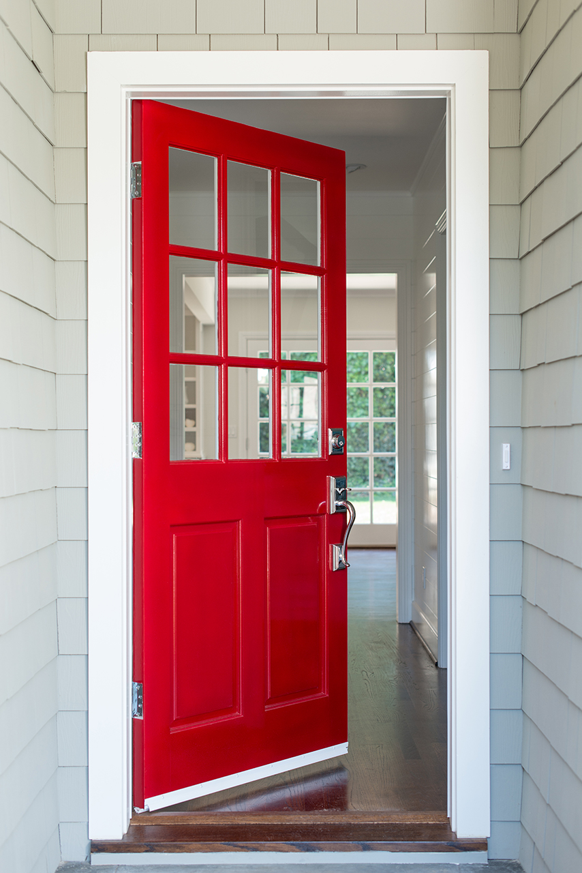
Welcome and Introductions
Marie and Brenna to briefly introduce themselves as co-chairs.
Incoming co-chair TBD.
Board members invited to introduce themselves to the group.

Slide 4
Approval of the Agenda
(Circulated by Email)
Overview of TRU Open Press and Advisory Board Terms of Reference.
Formation of Project Selection Subcommittee.
Strategic Goals for the Year.
Open Discussion.
Next Steps and Closing Remarks.

Slide 5

TRU Open Press Vision
The Open Press combines TRU’s celebrated open platforms and expertise in learning design and resource development to offer all-inclusive support for the development of open educational resources, scholarship, and pedagogy projects.
Our goal is to solidify the existing infrastructure to prepare for TRU’s transition to a research-first university and to support the existing community ethos of teaching and learning in the open.

Slide 6
Who We Are
Marie Bartlett and Brenna Clarke Gray:
co-founders and project leads
Dani Collins:
publications manager
Jessica Obando Almache:
production specialist
Kaitlyn Meyers:
copy editor
Ananya Kamboj:
co-op student
Riley Philips:
co-op student
Greg Vilac:
co-op student

Slide 7
In Year One, we focused on funding orphaned projects.
Publications Manager Dani Collins will speak to some of the projects undertaken and completed with Year One funds.
In Year Two, excitingly, we are moving into our adjudicated project model.

Slide 8
The Purpose of the Advisory Board
To represent constituency groups important to the development of Press projects.
To advise Press leadership on academic standards, potential partnerships, financial sustainability, innovation, and inclusive practices.
To act as ambassadors for the TRU Open Press.
To select projects for development by the Press.

Slide 9
Review and Approval of the Terms of Reference
Circulated by email with the agenda.

Slide 10
Formation of the Project Selection Subcommittee
This Subcommittee will:
  Review projects after intake (1 May) according to the Project Review Matrix.
  Decide by consensus which projects will be funded.
  Complete their work ASAP, in time for funds to be disbursed by 1 September.
  Re-convene if funds allow for a second call mid-cycle.
The Subcommittee must consist of a five people, including one Chair and (at least) one student representative.
The Publications Manager will act as an advisor to the subcommittee.

Slide 11
Formation of the Project Selection Subcommittee
The co-chairs nominate Jamie Drozda to Chair the project selection subcommittee.
Call for remaining 4 subcommittee members.
If necessary, vote.

Slide 12
Strategic Goals for the Year
Support the Press-related needs of the TRU Honours College and any other TRUScholars–funded projects.
Maximize the disbursement of funds to open projects across the campus community, with attention to diversity of projects and number of areas of campus touched.
Maximize the student opportunities funded by the Press.
Work towards sustainable funding for the Press.

Slide 13
Question to the Board
How can we promote open education resource development, scholarly research publishing, and open pedagogy?

Slide 14

Open Discussion

Slide 15
Closing Remarks
Next meeting to be held in September, date TBA.
  Project Selection Subcommittee will report out on its work.
  Publications Manager will report out on the summer work of the Press.
  New co-chair to be introduced.
Project Selection Subcommittee can expect to hear from Dani about adjudication.
Gratitude from Brenna & Marie for the contributions of everyone here today.

